Slide 1
Chapter 1: JDBC Fundamentals

Slide 2
Learning Objectives
Introduction
JDBC Architecture
JDBC Driver Types: Type-1, Type-2, Type-3
JDBC Connectors
Connecting to databases with JDBC
Working with Tables
Statements and Execution

Slide 3
Introduction: JDBC API
JDBC API is a Java API that can access any kind of tabular data, especially data stored in a Relational Database. JDBC works with Java on a variety of platforms, such as Windows, Mac OS, and the various versions of UNIX.
JDBC stands for Java Database Connectivity, which is a standard Java API for database-independent connectivity between the Java programming language and a wide range of databases.
The JDBC library includes APIs for each of the tasks mentioned below that are commonly associated with database usage.
Making a connection to a database.
Creating SQL or MySQL statements.
Executing SQL or MySQL queries in the database.
Viewing & Modifying the resulting records.

Slide 4
JDBC Architecture
The JDBC API supports both two-tier and three-tier processing models for database access but in general, JDBC Architecture consists of two layers −
JDBC API: This provides the application-to-JDBC Manager connection.
JDBC Driver API: This supports the JDBC Manager-to-Driver Connection.
The JDBC API uses a driver manager and database-specific drivers to provide transparent connectivity to heterogeneous databases.
The JDBC driver manager ensures that the correct driver is used to access each data source. The driver manager is capable of supporting multiple concurrent drivers connected to multiple heterogeneous databases.

Slide 5
JDBC Architecture

Slide 6
Common JDBC Components
The JDBC API provides the following interfaces and classes −
DriverManager: This class manages a list of database drivers. Matches connection requests from the java application with the proper database driver using communication sub protocol. The first driver that recognises a certain subprotocol under JDBC will be used to establish a database Connection.
Driver: This interface handles the communications with the database server. You will interact directly with Driver objects very rarely. Instead, you use DriverManager objects, which manages objects of this type. It also abstracts the details associated with working with Driver objects.
Connection: This interface with all methods for contacting a database. The connection object represents communication context, i.e., all communication with database is through connection object only.
Statement: You use objects created from this interface to submit the SQL statements to the database. Some derived interfaces accept parameters in addition to executing stored procedures.
ResultSet: These objects hold data retrieved from a database after you execute an SQL query using Statement objects. It acts as an iterator to allow you to move through its data.
SQLException: This class handles any errors that occur in a database application.

Slide 7
JDBC Driver Types
What is JDBC Driver?
JDBC drivers implement the defined interfaces in the JDBC API, for interacting with your database server.
For example, using JDBC drivers enable you to open database connections and to interact with it by sending SQL or database commands then receiving results with Java.
The Java.sql package that ships with JDK, contains various classes with their behaviours defined and their actual implementations are done in third-party drivers. Third party vendors implements the java.sql.Driver interface in their database driver.
JDBC Drivers Types
Type 1: JDBC-ODBC Bridge Driver
Type 2: JDBC-Native API
Type 3: JDBC-Net pure Java
Type 4: 100% Pure Java

Slide 8
Type 1: JDBC-ODBC Bridge Driver
In a Type 1 driver, a JDBC bridge is used to access ODBC drivers installed on each client machine. Using ODBC, requires configuring on your system a Data Source Name (DSN) that represents the target database.
When Java first came out, this was a useful driver because most databases only supported ODBC access but now this type of driver is recommended only for experimental use or when no other alternative is available.

Slide 9
Type 2: JDBC-Native API
In a Type 2 driver, JDBC API calls are converted into native C/C++ API calls, which are unique to the database. These drivers are typically provided by the database vendors and used in the same manner as the JDBC-ODBC Bridge. The vendor-specific driver must be installed on each client machine.
If we change the Database, we have to change the native API, as it is specific to a database and they are mostly obsolete now, but you may realize some speed increase with a Type 2 driver, because it eliminates ODBC's overhead.

Slide 10
Type 3: JDBC-Net pure Java
In a Type 3 driver, a three-tier approach is used to access databases. The JDBC clients use standard network sockets to communicate with a middleware application server. The socket information is then translated by the middleware application server into the call format required by the DBMS, and forwarded to the database server.
This kind of driver is extremely flexible, since it requires no code installed on the client and a single driver can actually provide access to multiple databases.

Slide 11
Type 4: 100% Pure Java
In a Type 4 driver, a pure Java-based driver communicates directly with the vendor's database through socket connection. This is the highest performance driver available for the database and is usually provided by the vendor itself.
This kind of driver is extremely flexible, you don't need to install special software on the client or server. Further, these drivers can be downloaded dynamically.

Slide 12
Which Driver should be Used?
If you are accessing one type of database, such as Oracle, Sybase, or IBM, the preferred driver type is 4.
If your Java application is accessing multiple types of databases at the same time, type 3 is the preferred driver.
Type 2 drivers are useful in situations, where a type 3 or type 4 driver is not available yet for your database.
The type 1 driver is not considered a deployment-level driver, and is typically used for development and testing purposes only.

Slide 13
Making a JDBC Connection
Steps:
Import JDBC Packages
Register JDBC Driver (for very old drivers - after JDBC version 4 most drivers register themselves automatically).
Database URL Formulation
Create Connection Object

Slide 14
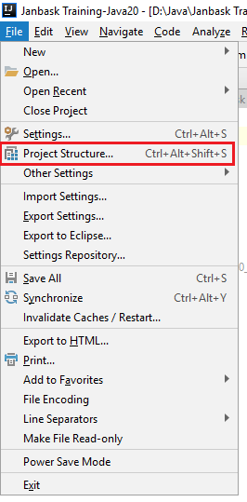
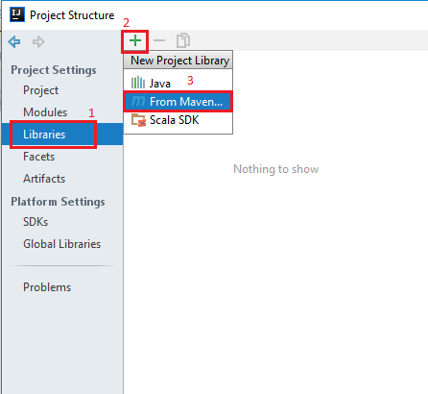
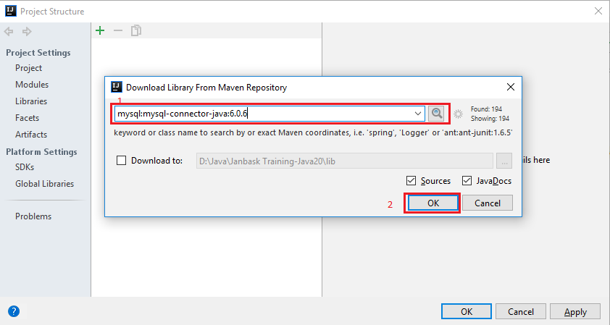
Adding the driver dependency to your project
2
1
3

Slide 15
How To: JDBC Connection
After you've installed the appropriate driver, it is time to establish a database connection using JDBC.
The programming involved to establish a JDBC connection is fairly simple. Here are these simple four steps −Import JDBC Packages:
Add import statements to your Java program to import required classes in your Java code.
Register JDBC Driver: This step causes the JVM to load the desired driver implementation into memory so it can fulfill your JDBC requests.
Database URL Formulation: This is to create a properly formatted address that points to the database to which you wish to connect.
Create Connection Object: Finally, code a call to the DriverManager object's getConnection( ) method to establish actual database connection.

Slide 16
Examples: Chapter 1
See JDBC-Chapter1 (SimpleConnection.java) at https://github.com/CompleteJavaTraining/AdvancedJava/tree/master/code/JDBC-Chapter1

Slide 17
Table
A table is a collection of related data held in a structured format within a database. It consists of columns, and rows.
In relational databases, and flat file databases, a table is a set of data elements (values) using a model of vertical columns (identifiable by name) and horizontal rows, the cell being the unit where a row and column intersect.
A table has a specified number of columns, but can have any number of rows.
Each row is identified by one or more values appearing in a particular column subset. The columns subset which uniquely identifies a row is called the primary key.
"Table" is another term for "relation"; although there is the difference in that a table is usually a multiset (bag) of rows where a relation is a set and does not allow duplicates. Besides the actual data rows, tables generally have associated with them some metadata, such as constraints on the table or on the values within particular columns

Slide 18
How To: Simple Data Fetch
Once a connection is obtained we can interact with the database. The JDBC Statement interface defines the methods and properties that enable you to send SQL or PL/SQL commands and receive data from your database.
They also define methods that help bridge data type differences between Java and SQL data types used in a database.
Before you can use a Statement object to execute a SQL statement, you need to create one using the Connection object's createStatement( ) method.
Once you've created a Statement object, you can then use it to execute an SQL statement with one of its three execute methods.boolean execute (String SQL):
Returns a boolean value of true if a ResultSet object can be retrieved; otherwise, it returns false. Use this method to execute SQL DDL statements or when you need to use truly dynamic SQL.
int executeUpdate (String SQL): Returns the number of rows affected by the execution of the SQL statement. Use this method to execute SQL statements for which you expect to get a number of rows affected - for example, an INSERT, UPDATE, or DELETE statement.
ResultSet executeQuery (String SQL): Returns a ResultSet object. Use this method when you expect to get a result set, as you would with a SELECT statement.
You should close the connection and statements in finally block of your code.

Slide 19
Examples: Chapter 1
See JDBC-Chapter1 (SimpleStatements.java) at https://github.com/CompleteJavaTraining/AdvancedJava/tree/master/code/JDBC-Chapter1

Slide 20
What are we learning in Next Chapter ?
You will learn about Advanced JDBC Concepts
We will learn about:
Exception Handling and Cleanup
Working with Stored Procedures
Working with Database Functions
Connection Interface
Connecting with DriverManager
Executing PreparedStatement
Executing CallableStatement
Batch Operations with JDBC

Slide 21
Thank You !

